Slide 1
Operating System
Study Of MOBILE OPERATING SYSTEM

Slide 2
RESTART_SYSCALL
restart_syscall - restart a system call after interruption by a stop
signal
DESCRIPTION
The restart_syscall() system call is used to restart certain system
calls after a process that was stopped by a signal (e.g., SIGSTOP or
SIGTSTP) is later resumed after receiving a SIGCONT signal. This
system call is designed only for internal use by the kernel.
RETURN VALUE
The return value of restart_syscall() is the return value of whatever
system call is being restarted.

Slide 3
_EXIT()
_exit, _Exit - terminate the calling process
DESCRIPTION
The function _exit() terminates the calling process "immediately".
Any open file descriptors belonging to the process are closed; any
children of the process are inherited by process 1, init, and the
process's parent is sent a SIGCHLD signal. The function _Exit() is equivalent to _exit().
RETURN VALUE
These functions do not return.

Slide 4
READ()
size_t read(int fd, void *buf, size_t count);
DESCRIPTION
read() attempts to read up to count bytes from file descriptor fd
into the buffer starting at buf.
On files that support seeking, the read operation commences at the current file offset, and the file offset is incremented by the number
of bytes read. If the current file offset is at or past the end of
file, no bytes ar
RETURN VALUE
On success, the number of bytes read is returned (zero indicates end
of file), and the file position is advanced by this number.e read, and read() returns zero.

Slide 5
_OPEN
Description:
Given a pathname for a file, open() returns a file descriptor, a small, nonnegative integer for use in subsequent system calls (read(2), write(2), lseek(2), fcntl(2), etc.). The file descriptor returned by a successful call will be the lowest-numbered file descriptor not currently open for the process. By default, the new file descriptor is set to remain open across an execve. A call to open() creates a new open file description, an entry in the system-wide table of open files. The open file description records the file offset and the file status flags (see below). A file descriptor is a reference to an open file description; this reference is unaffected if pathname is subsequently removed or modified to refer to a different file.
RETURN VALUE :
open(), openat(), and creat() return the new file descriptor, or -1 if an error occurred (in which case, errno is set appropriately).

Slide 6
_CHDIR
DESCRIPTION :
chdir() changes the current working directory of the calling process to the directory specified in path. fchdir() is identical to chdir(); the only difference is that the directory is given as an open file descriptor.
RETURN VALUE :
On success, zero is returned. On error, -1 is returned, and errno is set appropriately.

Slide 7
_LSEEK
DESCRIPTION :
The lseek() function repositions the offset of the open file associated with the file descriptor fd to the argument offset according to the directive whence as follows: SEEK_SET The offset is set to offset bytes. SEEK_CUR The offset is set to its current location plus offset bytes. SEEK_END The offset is set to the size of the file plus offset bytes. The lseek() function allows the file offset to be set beyond the end of the file (but this does not change the size of the file). If data is later written at this point, subsequent reads of the data in the gap (a "hole") return null bytes ('\0') until data is actually written into the gap.
RETURN VALUE :
Upon successful completion, lseek() returns the resulting offset location as measured in bytes from the beginning of the file. On error, the value (off_t) -1 is returned and errno is set to indicate the error.

Slide 8
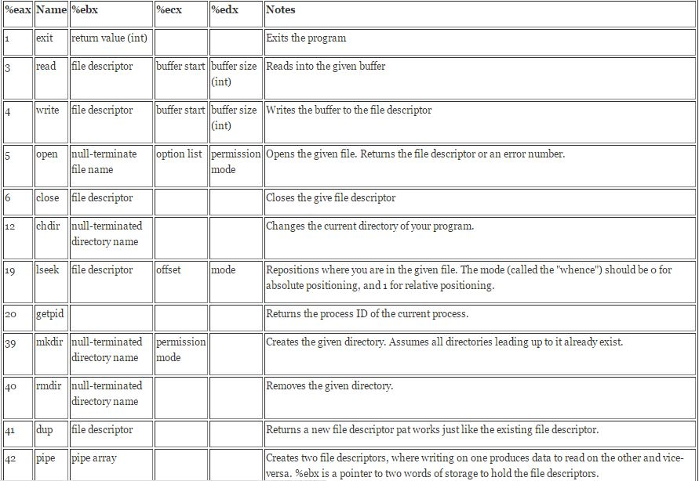
IMPORTANT SYSTEM CALLS IN SHORT

Slide 9


Slide 10


Slide 11
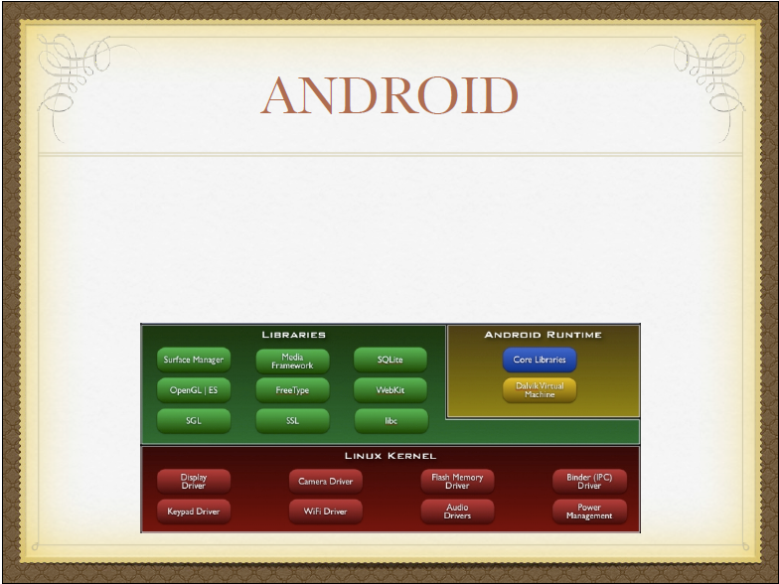

Slide 12
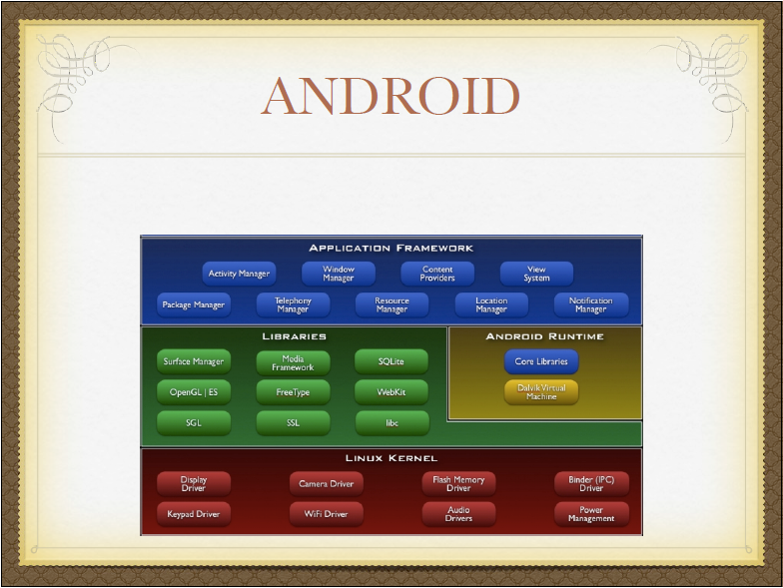

Slide 13
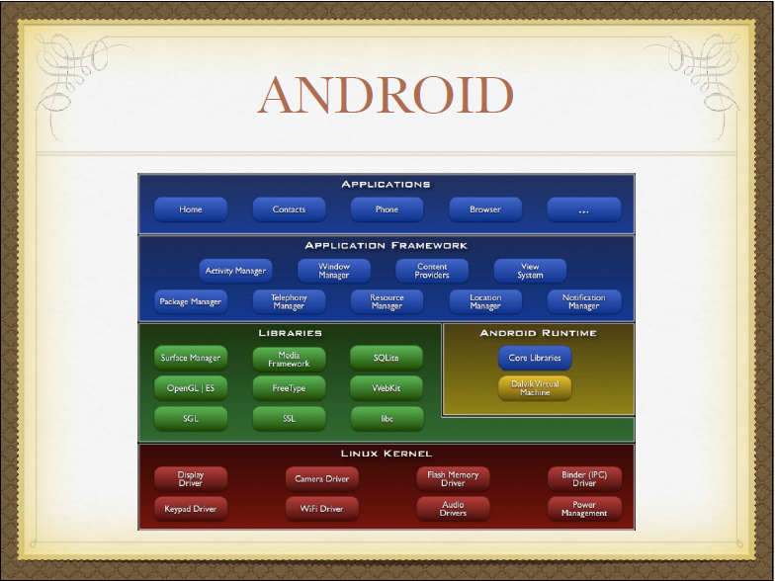

Slide 14
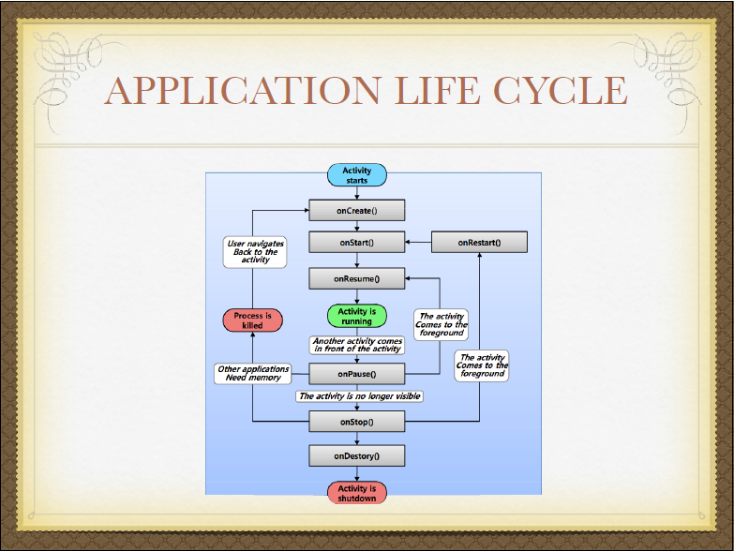

Slide 15
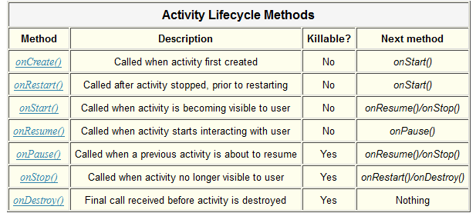

Slide 16
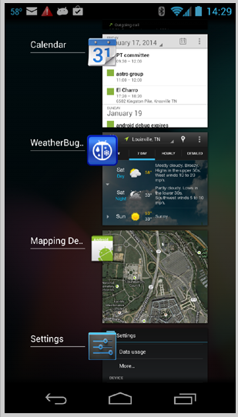
MULTITASKING

Slide 17
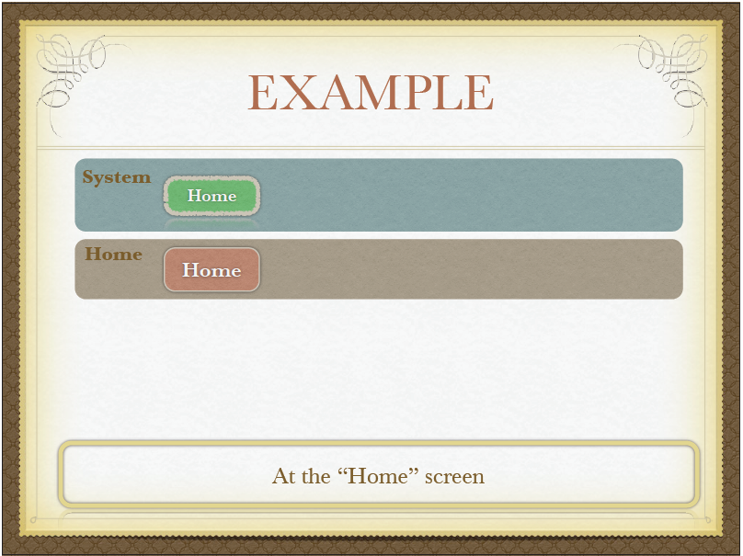

Slide 18
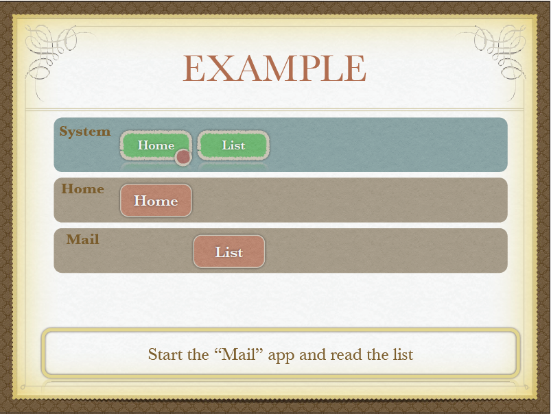

Slide 19


Slide 20
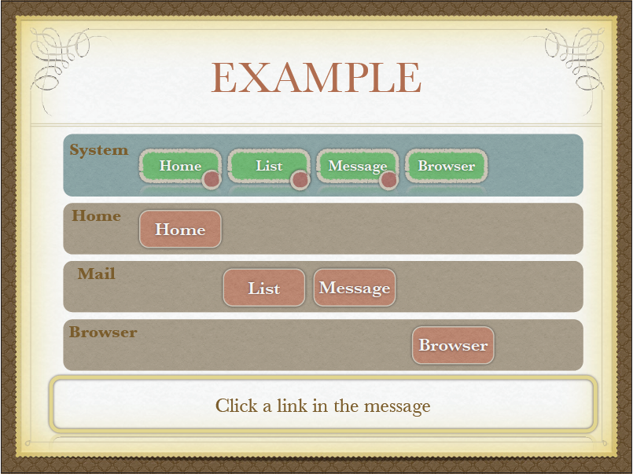

Slide 21
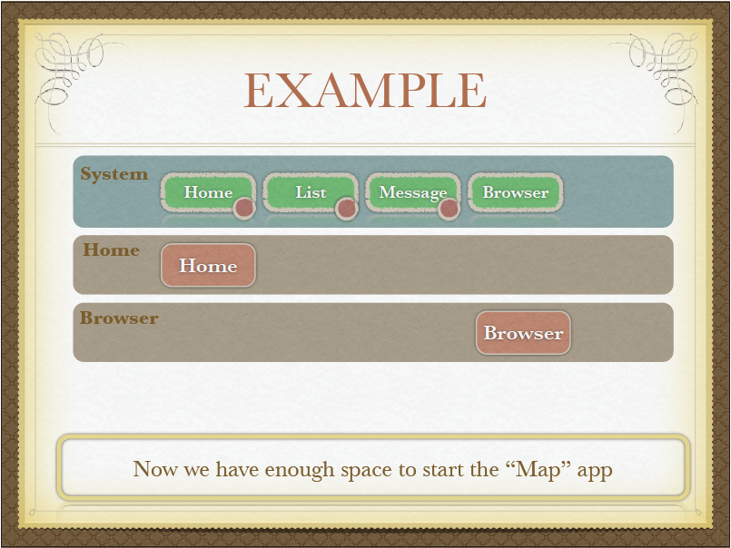

Slide 22
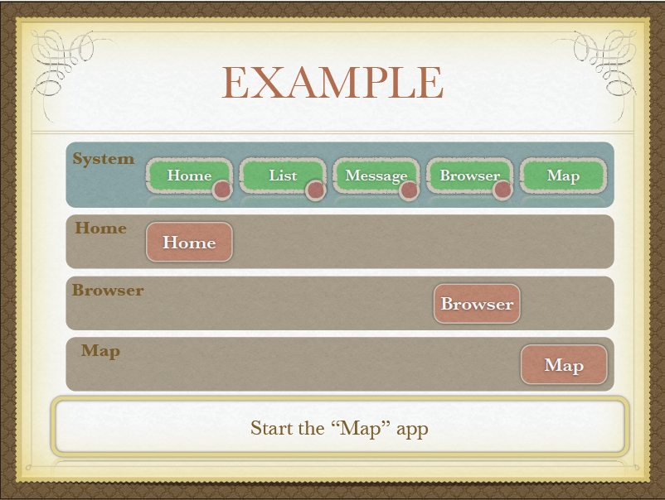

Slide 23
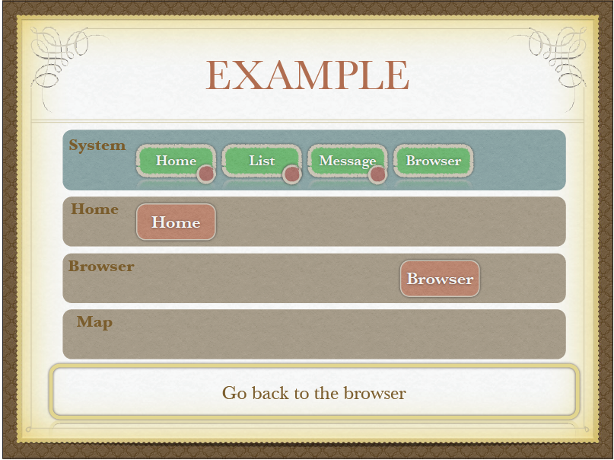

Slide 24
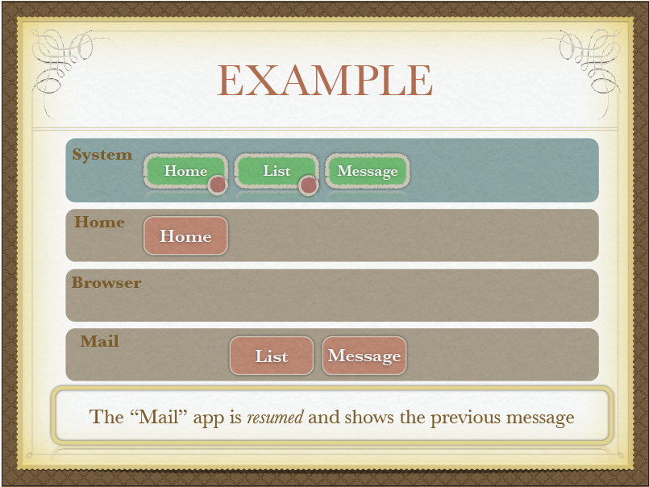

Slide 25
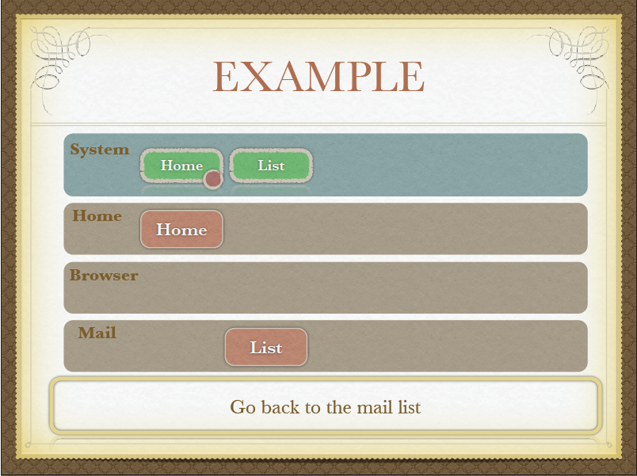

Slide 26


